Slide 1
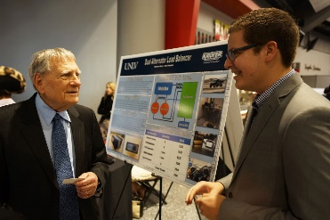

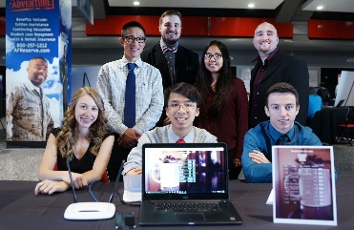
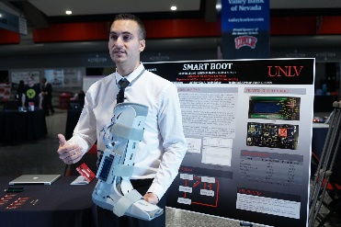
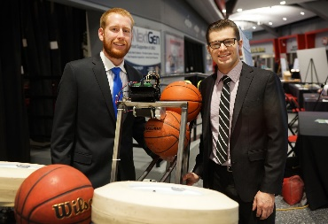
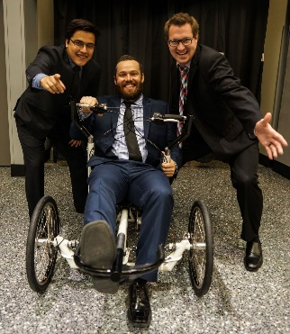
WELCOME to your spring 2025 senior design!

Slide 2
SENIOR DESIGN COMPETITION
Spring 2025
Competition:
Thursday, May 8, 2025 8am - 5pm
Location:
Engineering Complex

Slide 3
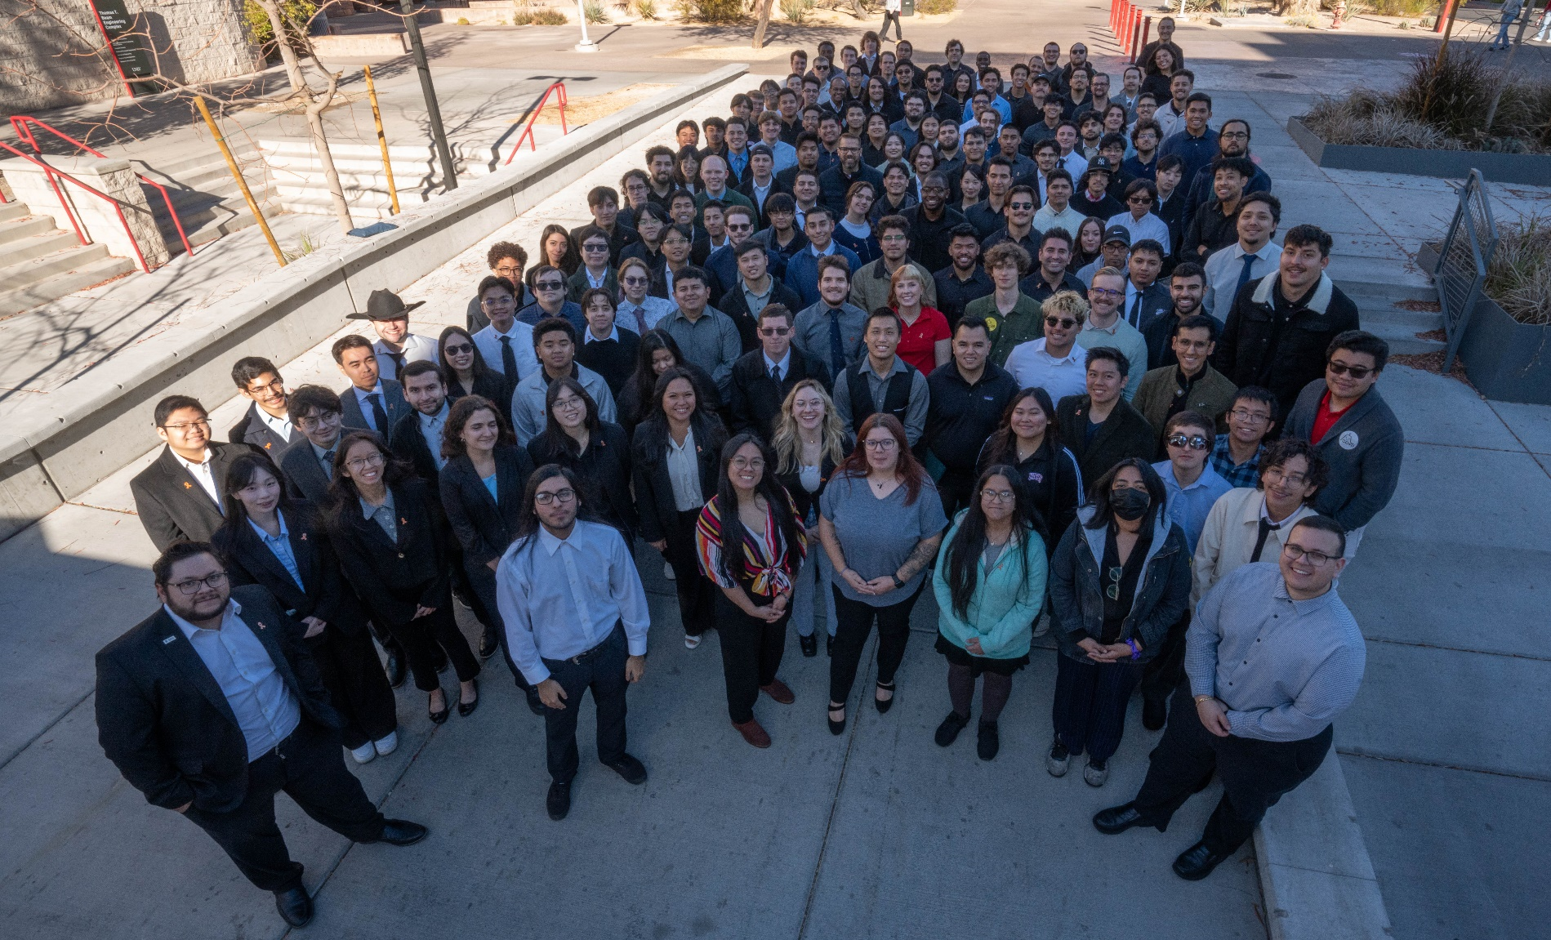
Class of Fall 2024 Senior Design

Slide 4
Professional Team Photos
Professional team photos will be taken at no charge on the dates and times below:
Monday, February 24th : 8AM-12PM*
&
Tuesday, February 25th : 12PM-5PM*
Location TBD. Professional attire for team photo.
*Time slots will be filled as received; these are the only 2 days we will take team photos.

Slide 5
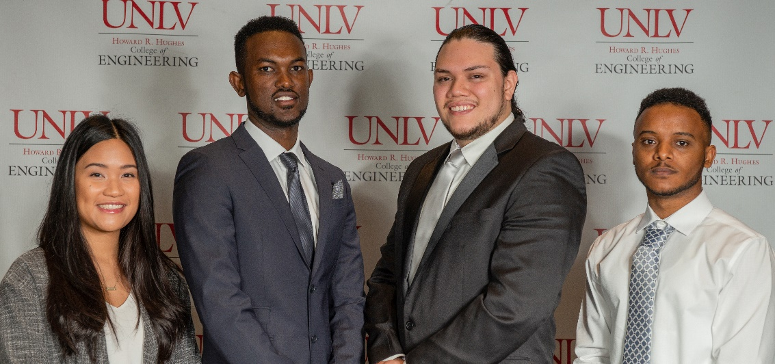
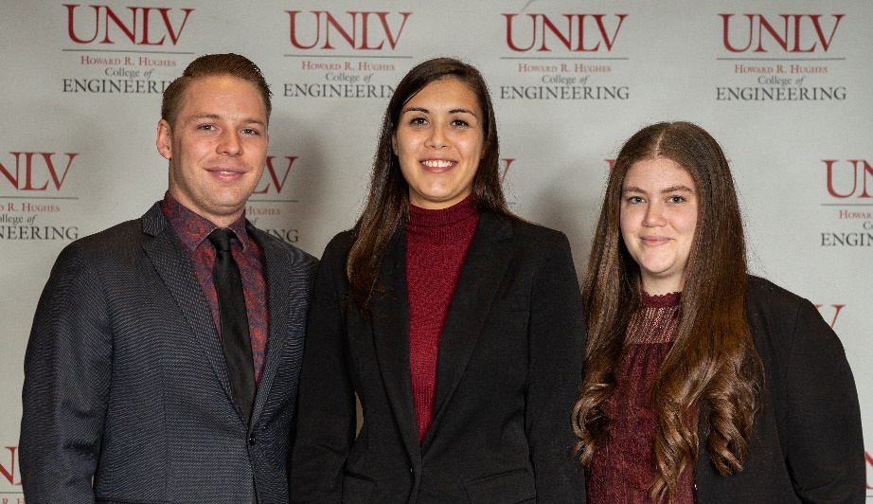
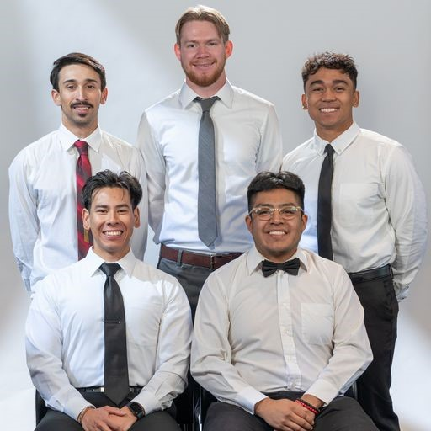
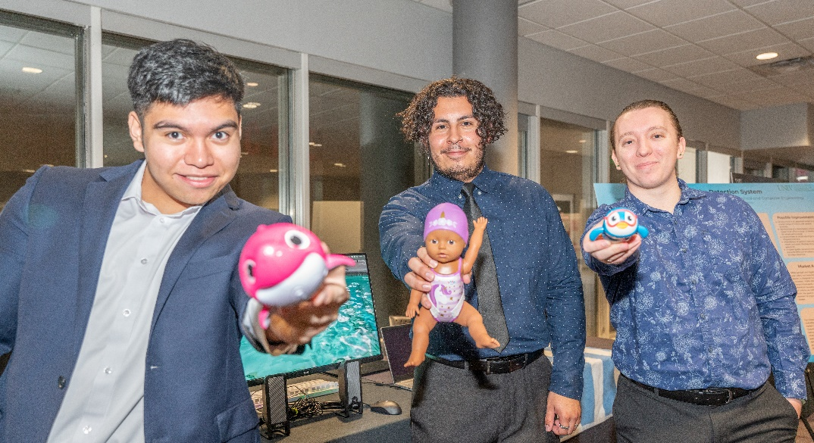
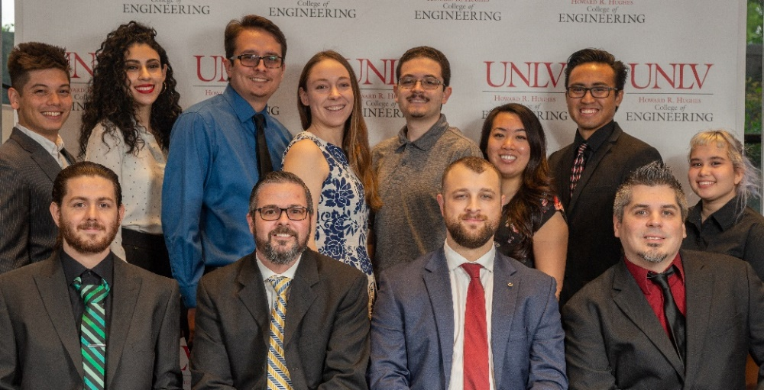

Slide 6
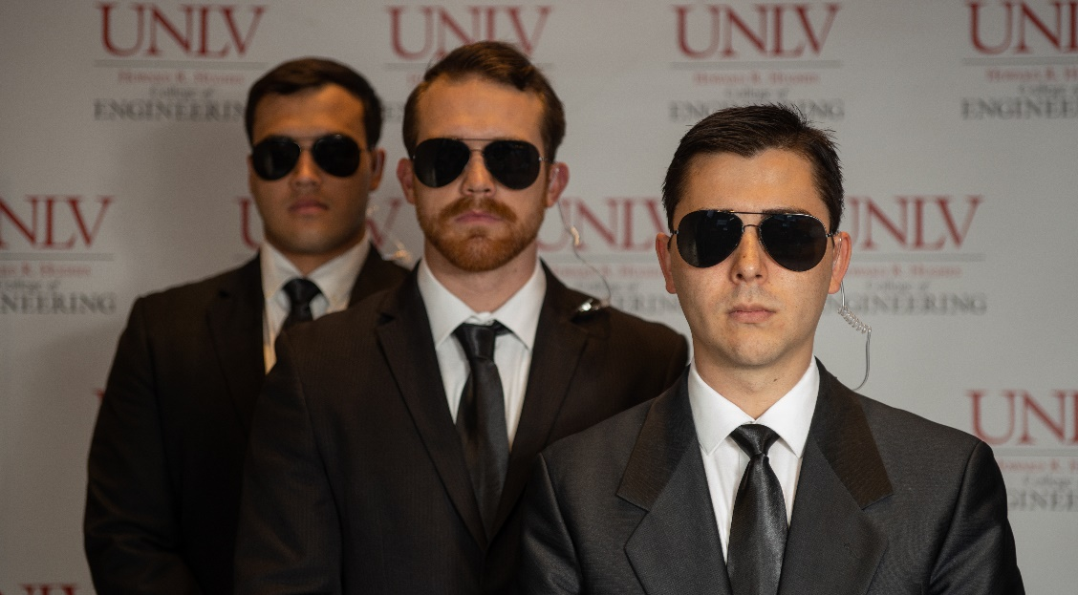
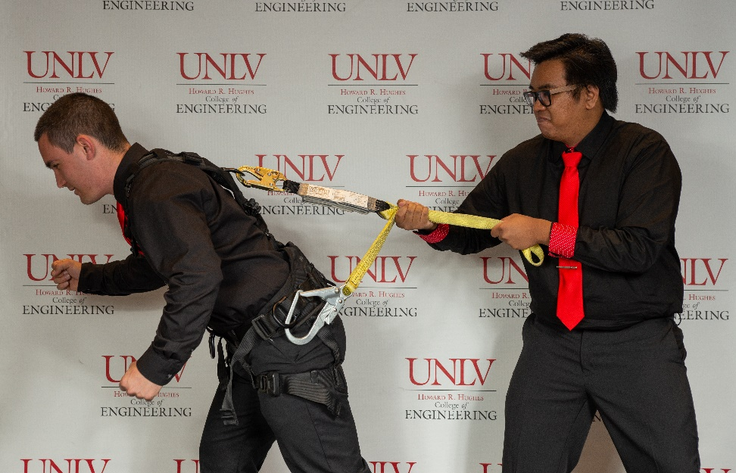
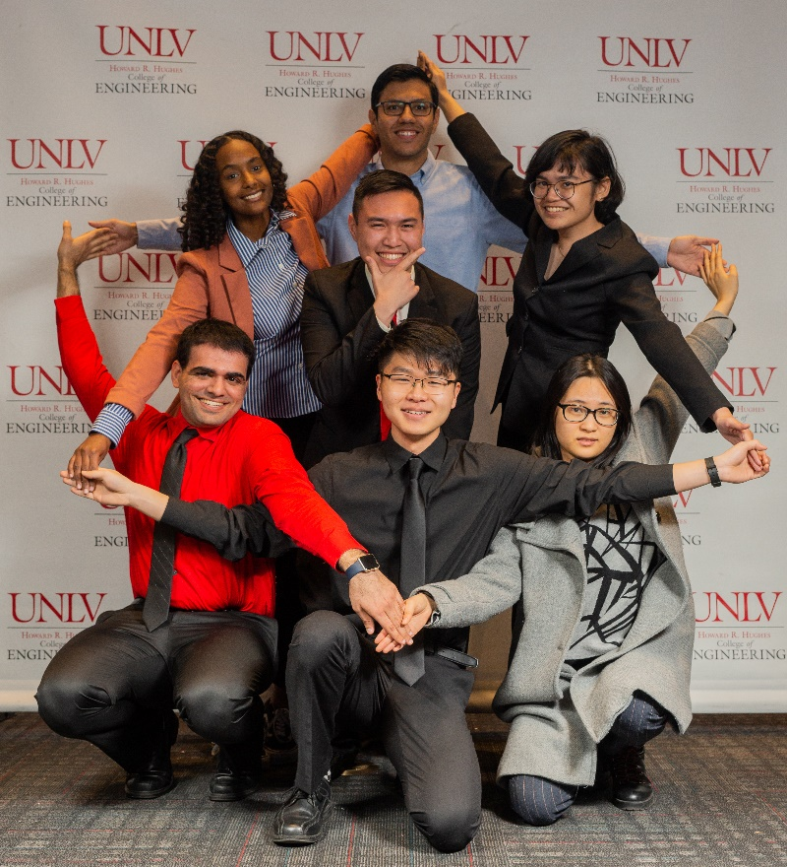
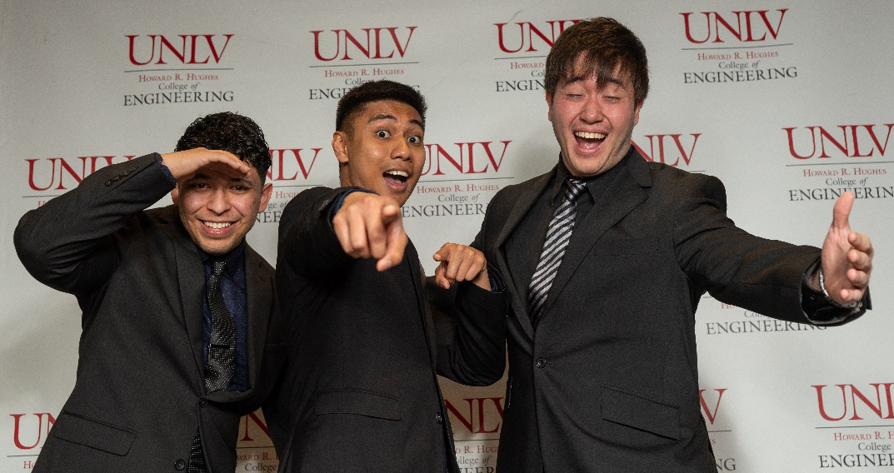

Slide 7
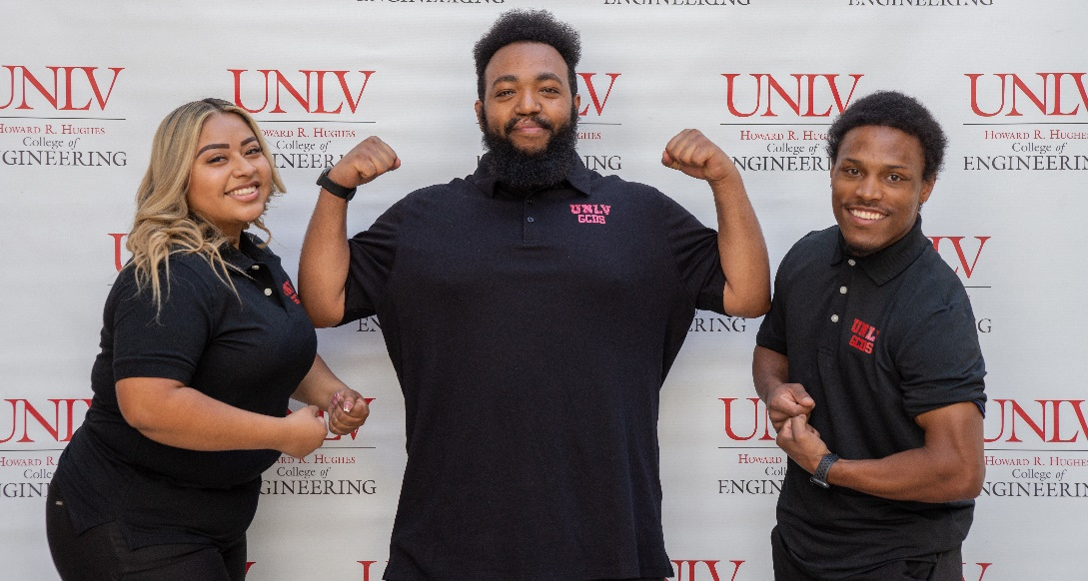
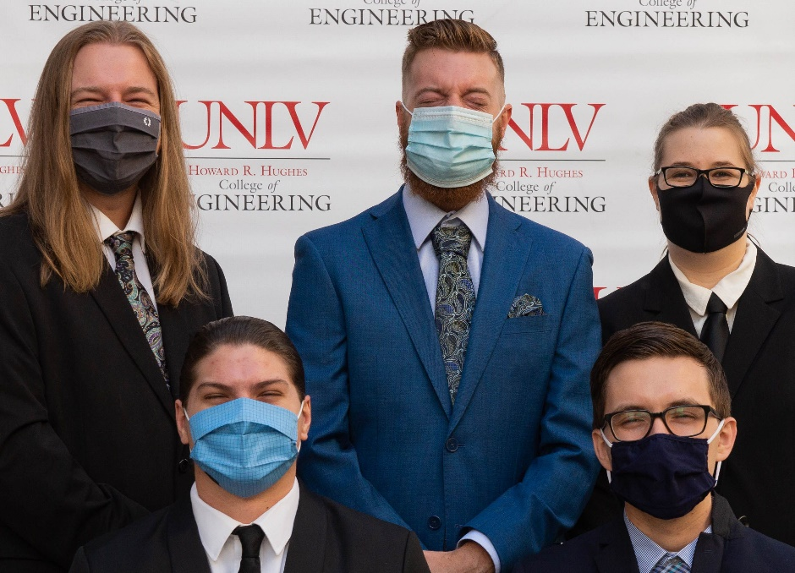
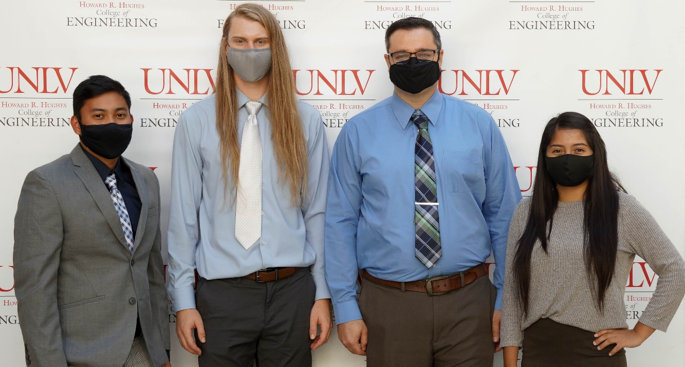

Slide 8
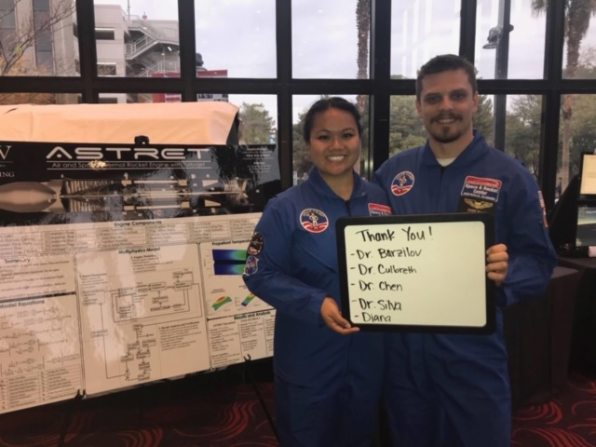
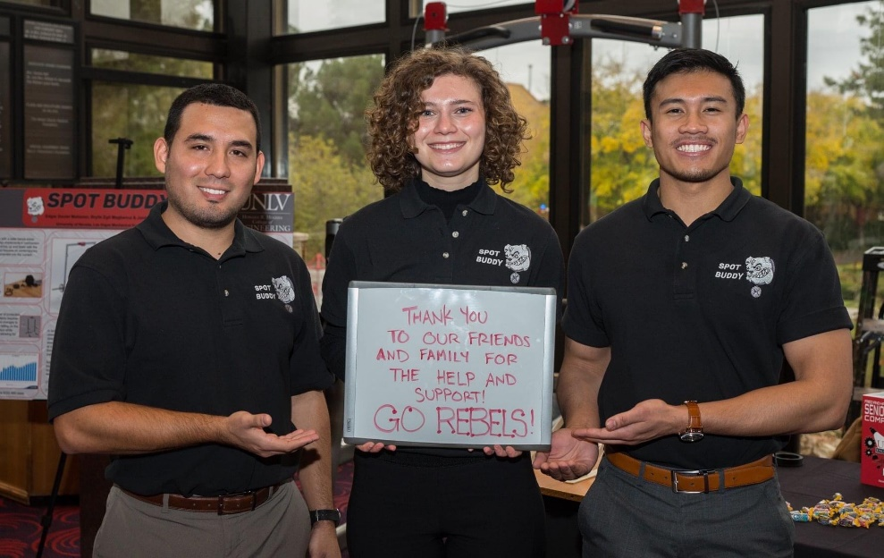
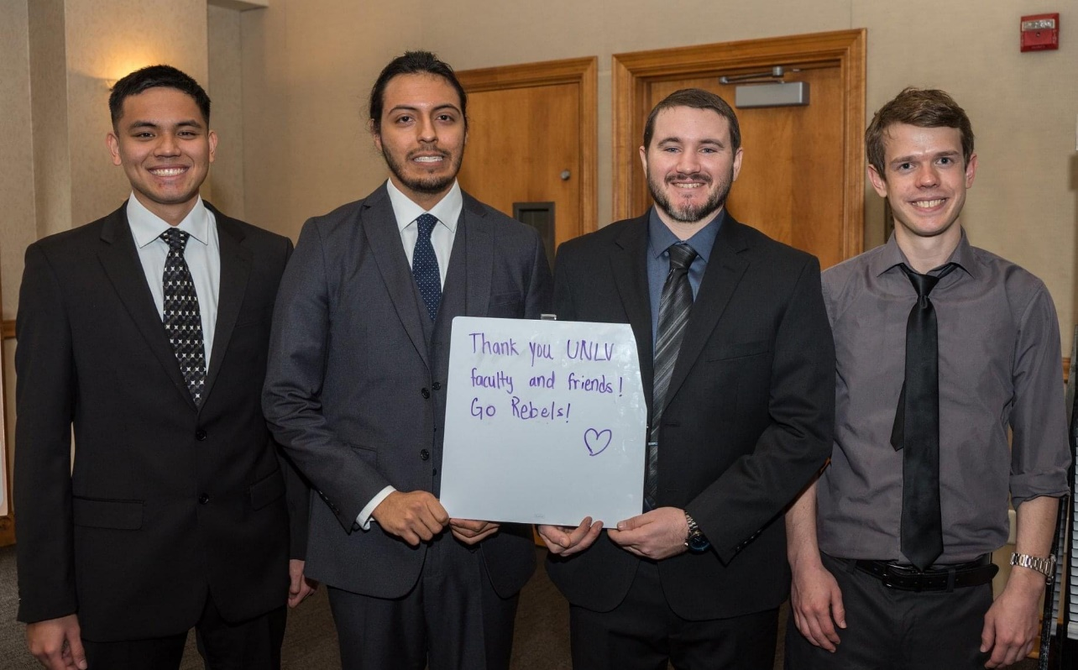
UNIFORMS
POLO SHIRTS
SUIT AND TIE

Slide 9
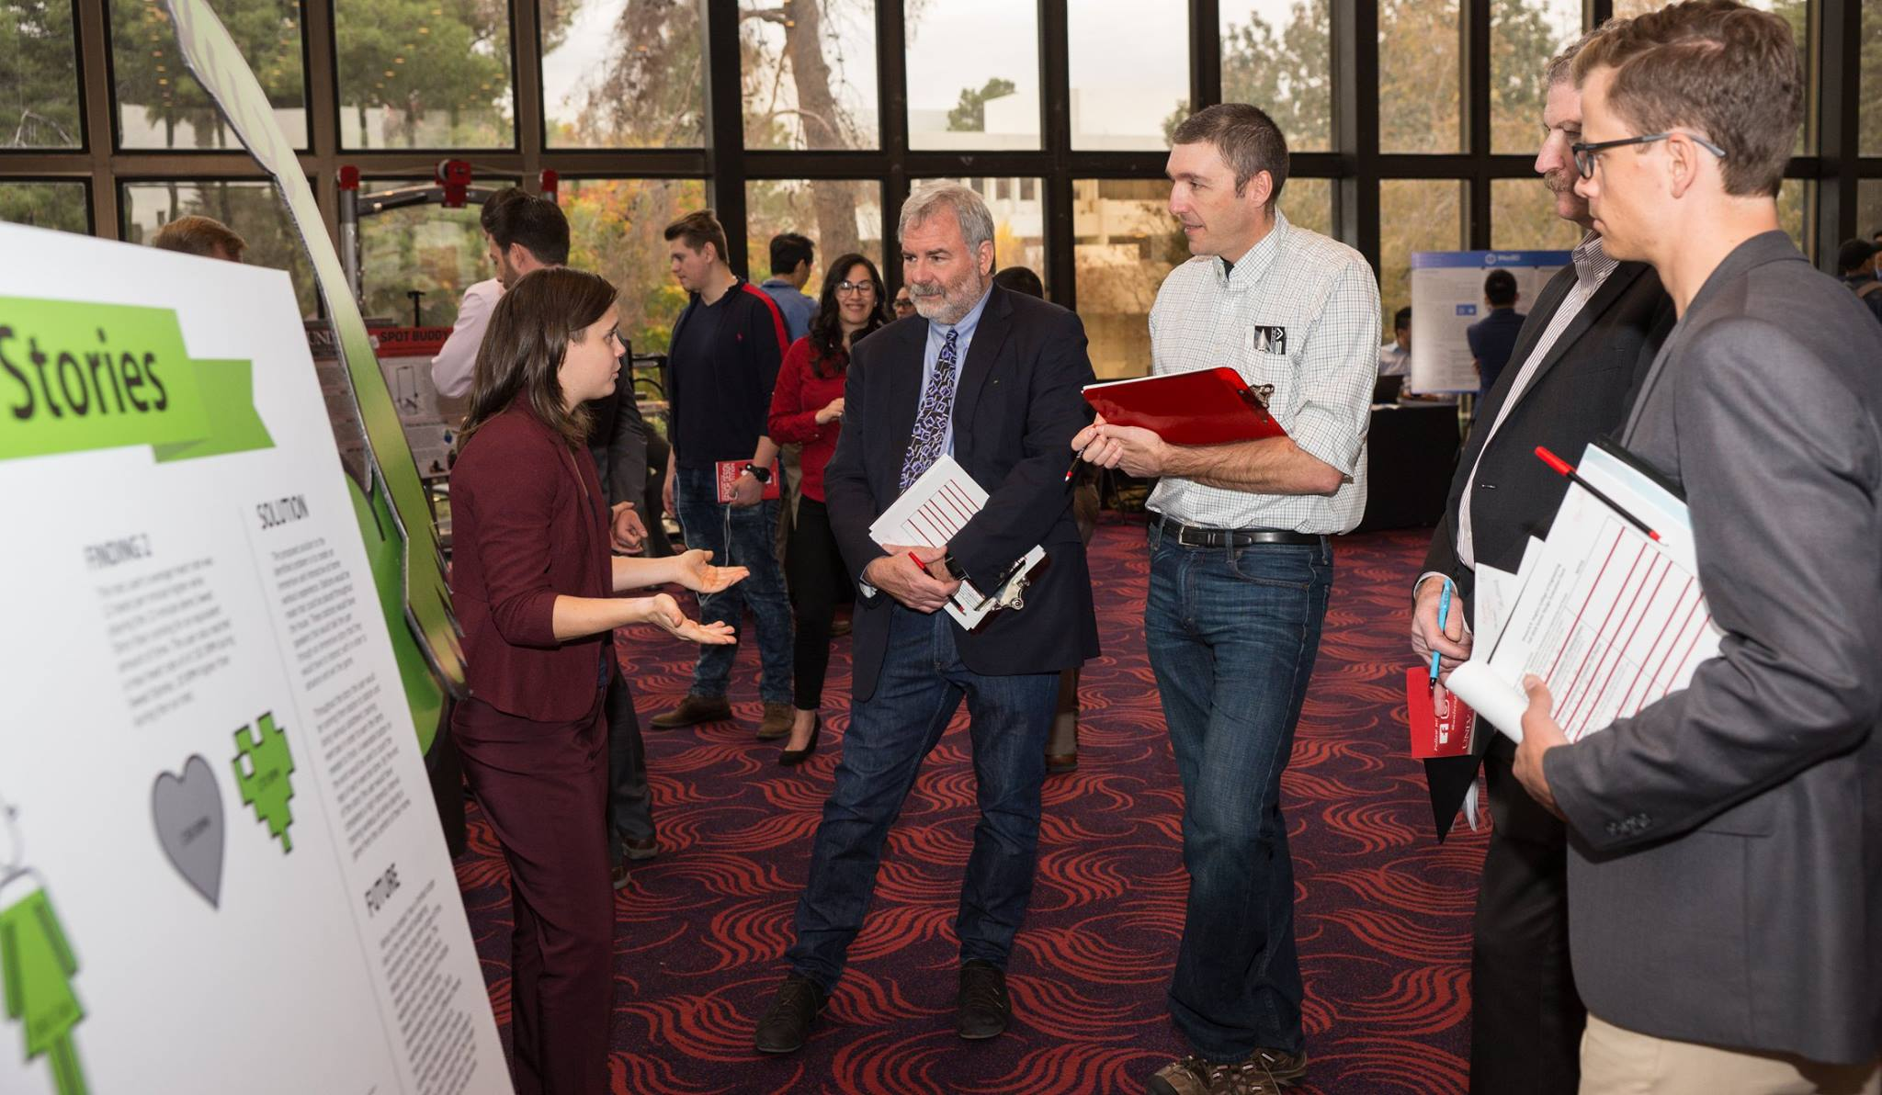
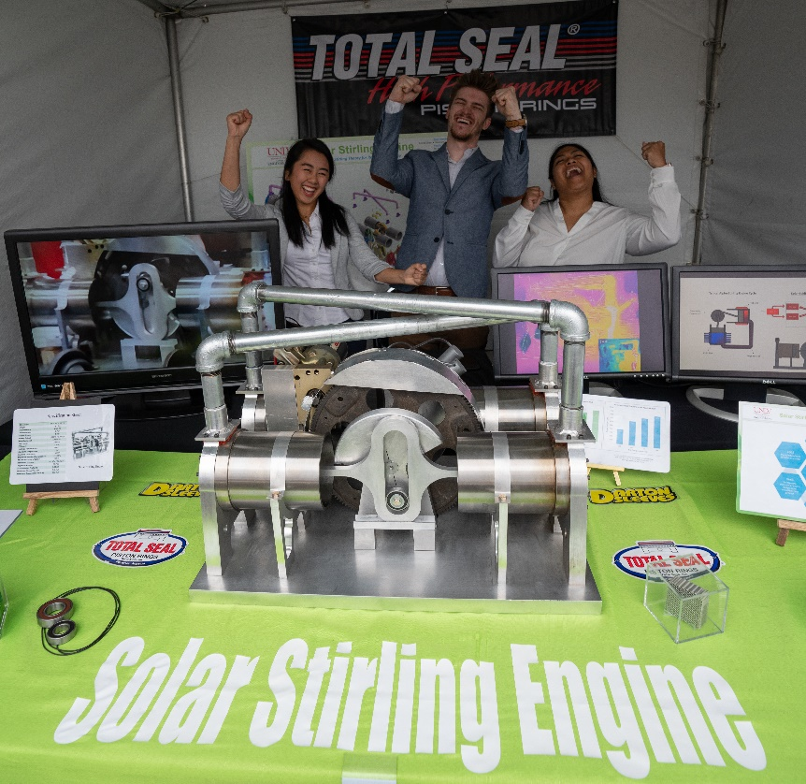
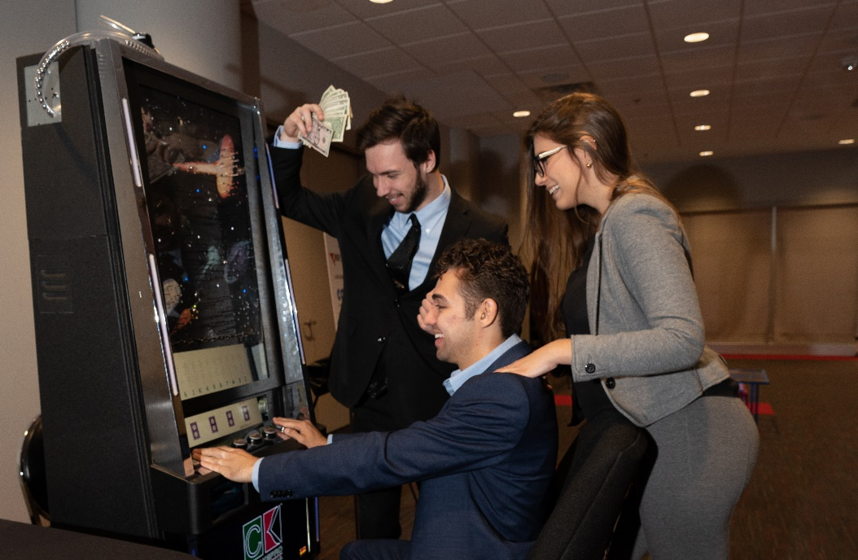

Slide 10
Poster file in pdf sized to 48x36 inches due to
Molly.marks@unlv.edu on or before 4.23.25
Please utilize the poster template that was provided
to you as well as the YouTube video link and
PowerPoint slides from previous
poster workshops.

Slide 11
NON-REIMBURSABLE ITEMS
Only teams that participate in the competition will be eligible for reimbursement.
Clothing
Computers/Laptops/Tablets
Smart Phones/Cell Phones
Printers
Consulting and/or Subcontracting Fees
Website Hosting, Building/Developing, Maintenance, Design, Etc.
Food and beverages
If your team feels that they need to purchase something from the above list please email Molly to see if an exception can be made.

Slide 12
SPECIAL NEEDS ITEMS
If your team does not request your special needs by the due date, March 1, 2025 then the special needs WILL NOT be met! It is your team's responsibility to submit your request for anything other than:
1 Table
1 Table Linen
1 Easel
2 Chairs

Slide 13
SPECIAL NEEDS ITEMS
You may request specially needed items from this list. We are unable to provide anything beyond the options available:
Electricity (Including number of outlets)
Extra Easels
Extra Space (restrictions due to location of event.)
Extra Tables
Internet (Wired or Wireless)
* We do NOT supply: Carts to move items, televisions, monitors, computers, etc.

Slide 14
PRIZES
**CEEC, CS, ECE, EED & ME
1st - $300 per student team member
2nd - $150 per student team member
**Interdisciplinary
$350 per student team member
*Commercial Potential
$325 per student team member
* Can be won in addition to department awards ** If the category only has one team competing, then the team score must be equivalent to other department scores to receive a prize.

Slide 15
PRIZES
*Sustainability
$225 per student team member
*Popular Choice
$125 per student team member
*Team Congeniality
$100 per student team member
*Innovation
$200 per student team member
Grand Prize
$500 per student team member
* Can be won in addition to department awards

Slide 16
AWARDS NIGHT!
WHEN: Friday, May 9, 2025, 6pm-9pm
WHERE: Cox Pavilion
WHO: Senior Design students, guests, faculty, staff and donors
WHY: To recognize all that you have done throughout your College of
Engineering Journey
PLANNED AGENDA:
6:00PM – Doors open to Cox Pavilion for dinner
6:45PM- Awards begins
9:00PM – Awards conclude

Slide 17
DINNER DETAILS
STUDENTS AND 1 GUEST ARE FREE TO ATTEND
ADDITIONAL GUESTS ARE $75
DEADLINE TO RSVP FOR AWARDS RECEPTION IS
April 28, 2025
TO RSVP YOU MUST COMPLETE THE RSVP FORM, EVEN IF YOU ARE NOT BRINGING ADDITIONAL GUESTS

Slide 18
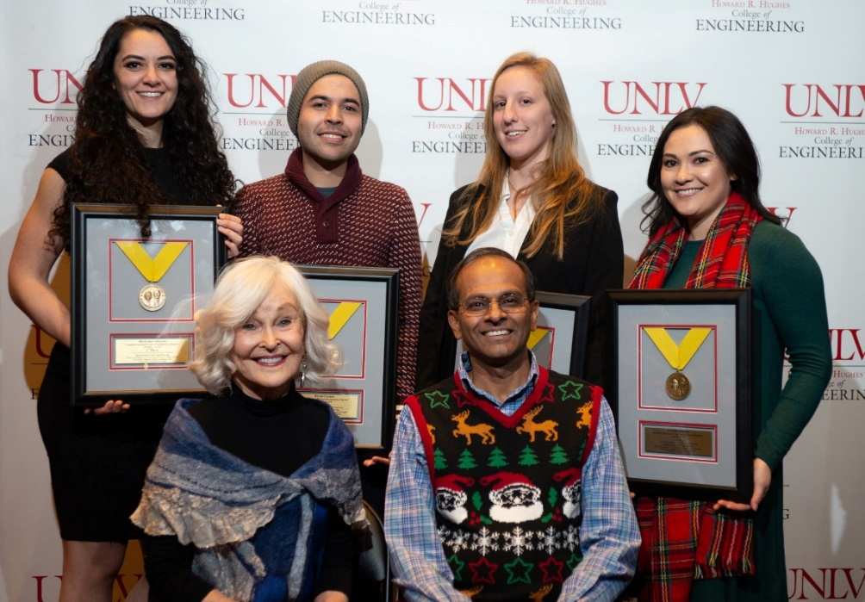
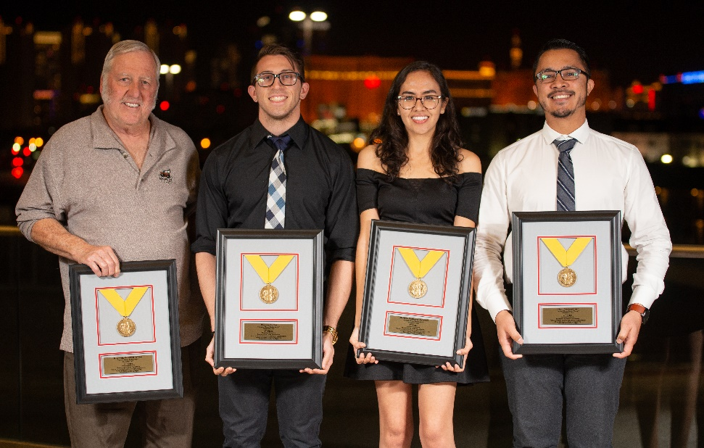
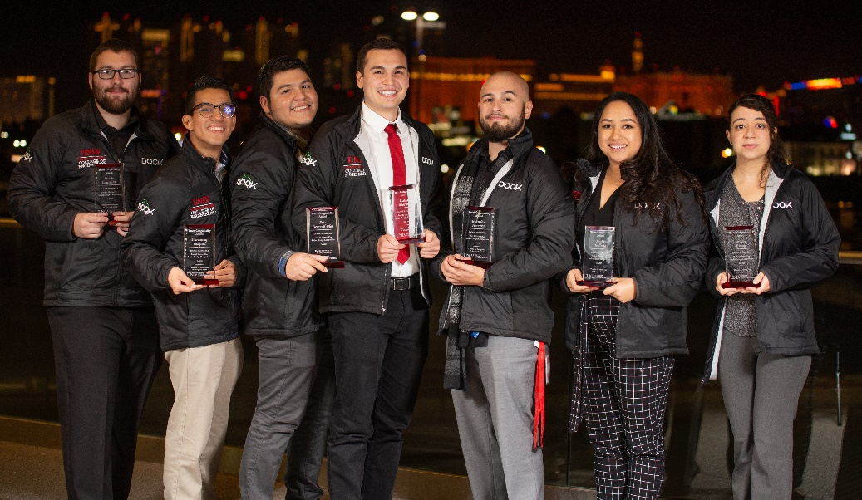
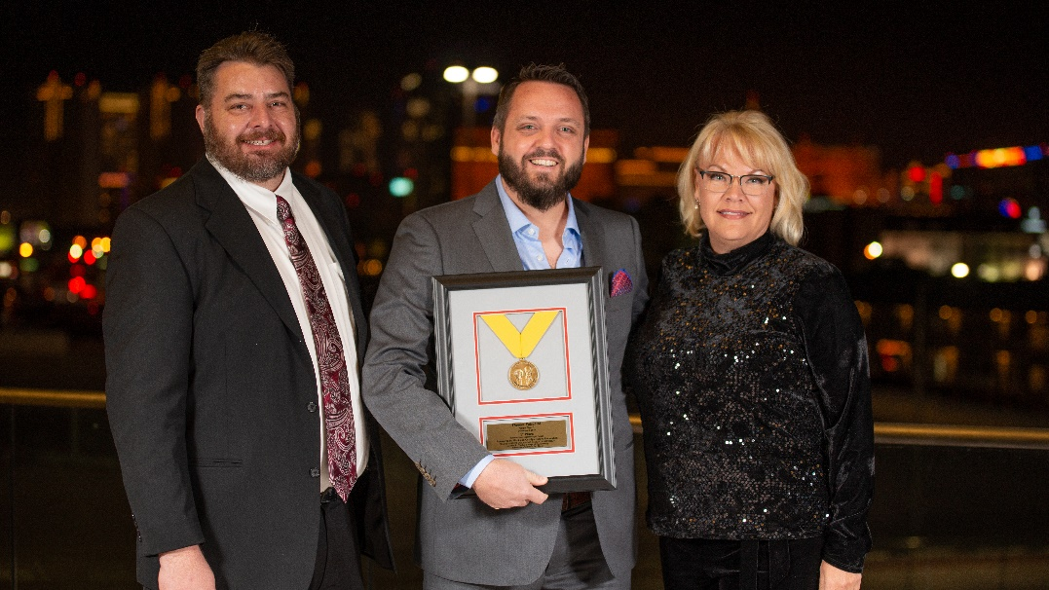

Slide 19
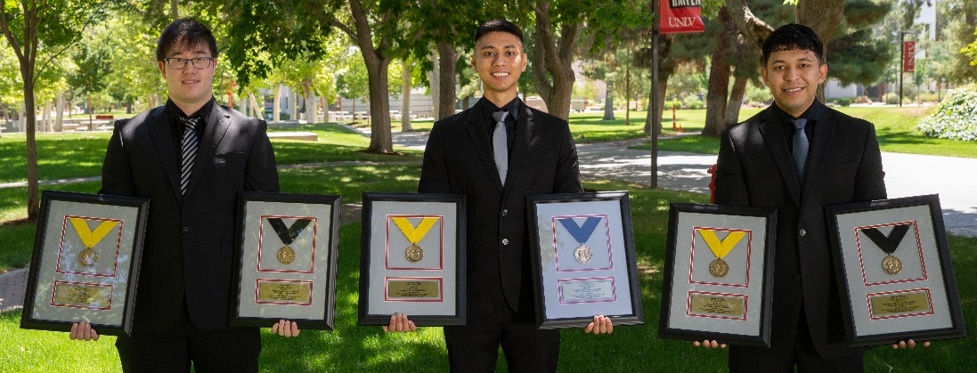
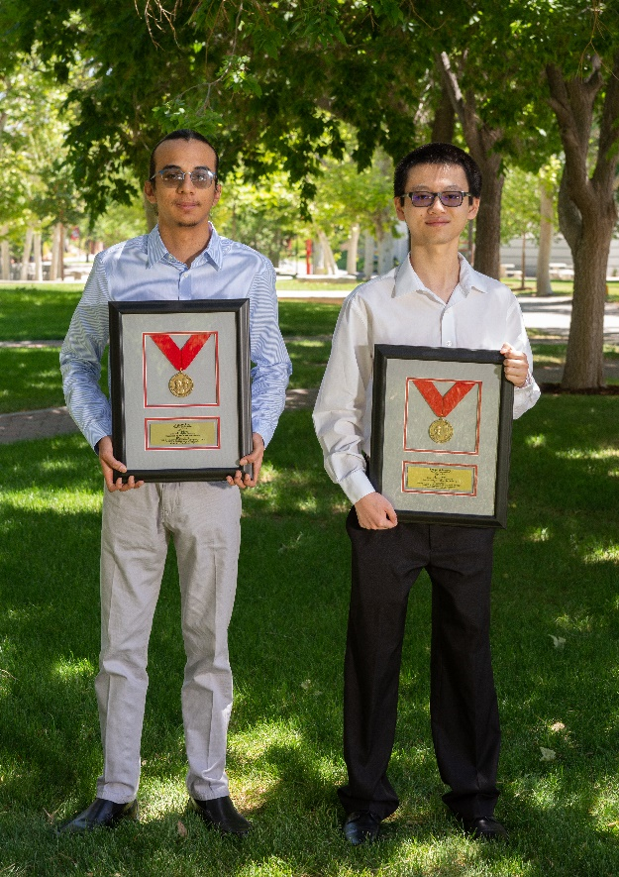
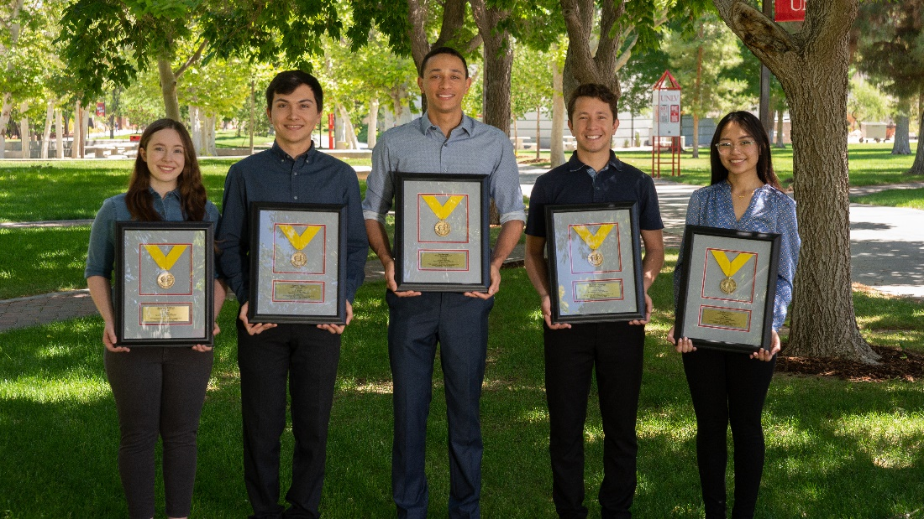
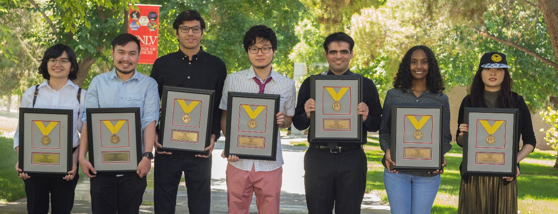

Slide 20
IMPORTANT DATES/DEADLINES
1/27/25: Data contact sheet due
2/10/25: Last day to email Molly to schedule a Team Photo
2/19/25: Project Abstracts– Email to Molly at molly.marks@unlv.edu as a WORD doc
2/24/25: Professional Photos Day 1: 8am-12pm
2/25/25: Professional Photos Day 2: 12pm-5pm
2/25/25: Final day to drop from the competition!
3/1/25: Last day to submit special needs request
3/25/25: Presentation times emailed to students

Slide 21
IMPORTANT DATES/DEADLINES
4/23/25: Poster PDF file due to Molly at molly.marks@unlv.edu
4/28/25: RSVP deadline for awards (link will be provided) student and one guest is free ($75 for additional guests) – MUST RSVP at link if attending
5/7/25: Set up, Engineering Complex, 10am-4pm
5/8/25: Competition, 8am-5pm, Engineering Complex
5/9/25: Awards Dinner, 6pm-9pm, Cox Pavilion
5/16/25: Reimbursement items (receipts & completed reimbursement document)
due to your department Administrative Assistant by 4:30pm- NO EXCEPTIONS
CEEC- Chandana.jamjam@unlv.edu
CS- Mario.martin@unlv.edu
ECE- Cameron.Williams@unlv.edu
ME- Chandashree.goddudharmegowda@unlv.edu
EED- Rachel.Soriano@unlv.edu
**Teams will only be reimbursed if they participated in the competition**
Teams MUST be present at awards or any monetary
award will be forfeited.

